Slide 1
Move To
Functional Programming

Slide 2
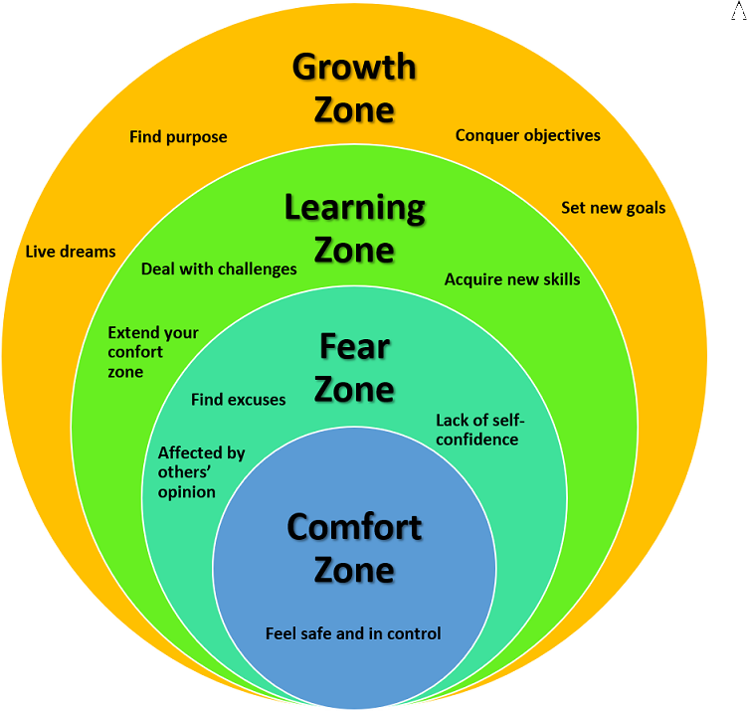
Move to functional
Are you safe and in control?

Slide 3
Move to functional
Agenda
Why?
Theory
Patterns
Snippets

Slide 4
Why?
Functional programming

Slide 5
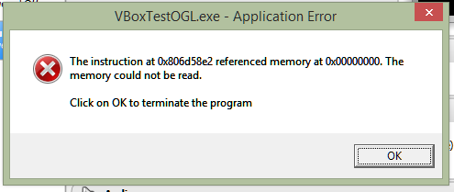
Move to functional
Why? The billion dollar mistake
NULL
Tony Hoare invented the null reference in 1965
NULL, null, Nothing, nil, nullptr, undef, undefined, None, …
Client must check ALWAYS the return value …
… to avoid null reference exception

Slide 6
Move to functional
Why? IF and SWITCH … I love them… ☹
IF and SWITCH
Cyclomatic complexity is a software metric, used to indicate the complexity of a program.
It is a quantitative measure of the number of linearly independent paths through a program's source code.

Slide 7
Move to functional
Why? Clean and Beautiful code
Readability
Composition of function let your code fluent
Without IF and with fluent programming the code is more declarative so it’s more readable
The code is more beautiful and so it works by definition

Slide 8
Theory
Functional programming

Slide 9
Move to functional
Functions
Functions are first class citizen
You can assign a function to a variable
You can pass a function as a parameter of another function
You can return a function as a result of another function
High Order Functions

Slide 10
Move to functional
Immutability
Avoiding state mutation and shared state
Function “must” be pure
Deterministic
No side effect
Mutate global state, Mutates input arguments, Throw exception, Perform any I/O operation
No race condition
Referential transparency
Function “must” be sincere (do what it says)

Slide 11
Move to functional
Functional programming paradigm
The imperative approach follows the principle of workflow control and answers the question ‘how to do’
The declarative approach describes the data flow and answers the question ‘what to do’

Slide 12
Move to functional
Unit instead Void
Modelling the absence of data
Void has a lot of problem because the compiler treat it as special value and we cannot write something like Func<Void>
The use of void in the functions means we have function with side effect because they don’t return anything
Unit is a type to represent the absence of data
Using Unit we can convert all the Action function into Func<Unit>
Every functions should return a value and void is a type with zero values

Slide 13
Move to functional
Datatypes
A datatype is a an abstraction that encapsulates one reusable coding pattern
These datatypes are generalised by having one or several generic parameter
Usually a data type is implemented by a struct to be immutable

Slide 14
Move to functional
Option<T>
Option<T> is a datatype that represents absence.
It is like a box containing or not the value
You can access the internal value using a Match function
The Some call back in case of value is present
The None call back in case of value is not present

Slide 15
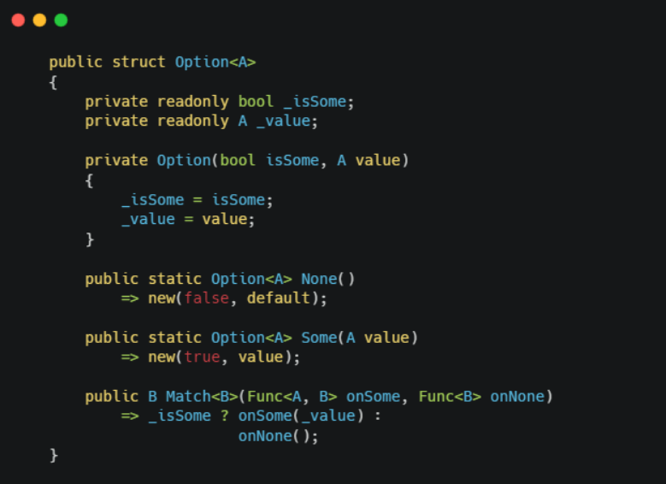
Move to functional
Option<T>

Slide 16
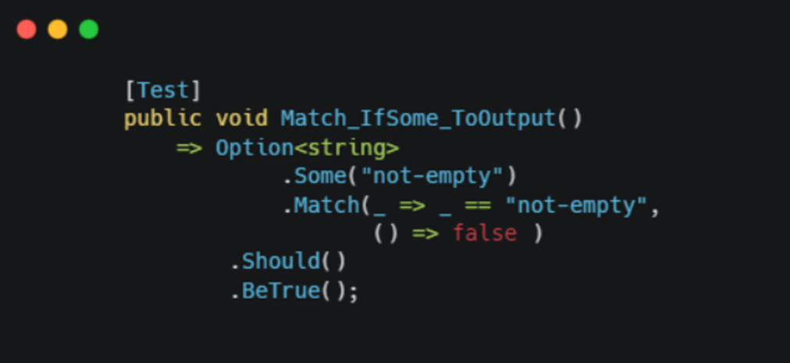
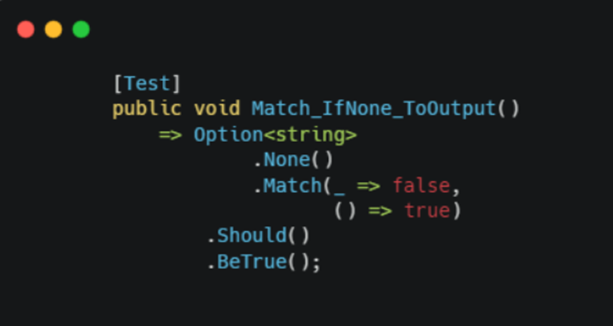
Move to functional
Option<T>

Slide 17
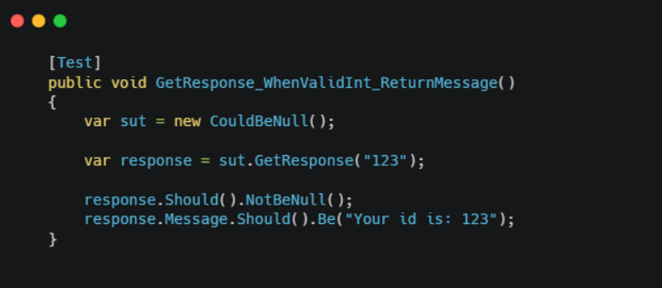
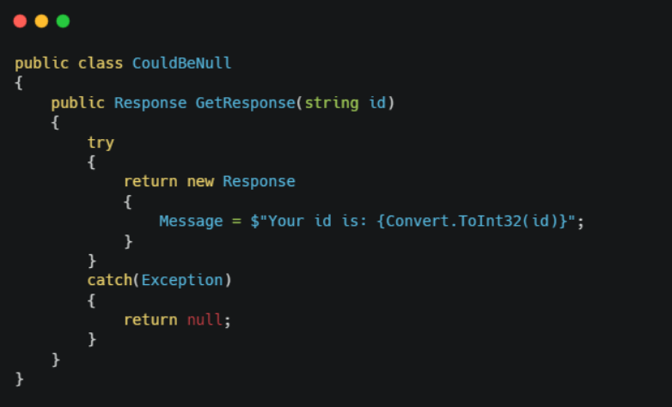
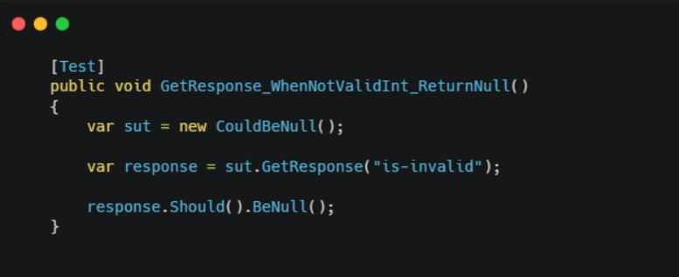
Move to functional
Option<T> … use case
Code is not safe, we have to check for NULL value

Slide 18
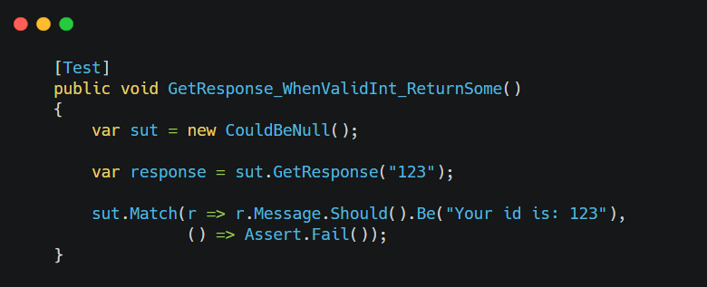
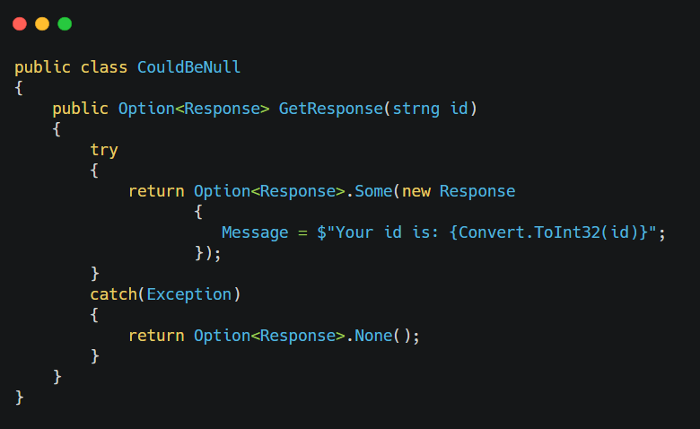
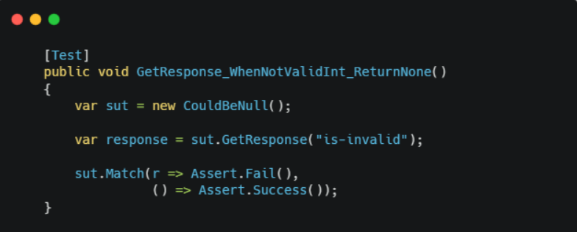
Move to functional
Option<T> … much better
Code is safe by design, no NULL to check

Slide 19
Move to functional
Either<L, R>
In the day by day work functions can fail, so we have to handle the errors
Either allows us to define two possible value for a function
The Right value when the computation is ok
The Left value in case of error

Slide 20
Move to functional
Either<L, R>

Slide 21
Move to functional
Either<L, R>

Slide 22
Move to functional
Either<L, R> … use case

Slide 23
Move to functional
Try monad
Try monad allow us to encapsulate into a function the exception handling
The Success value when the computation is ok without exception
The Exception value in case of exception

Slide 24
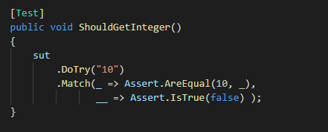
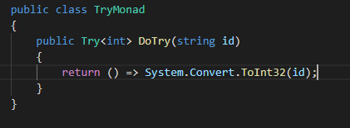
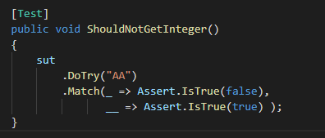
Move to functional
Try monad

Slide 25
Patterns
Functional programming

Slide 26
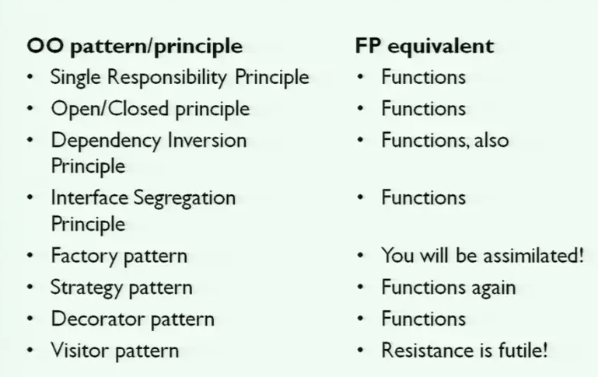
Move to functional
A lot of patterns…. ☺

Slide 27
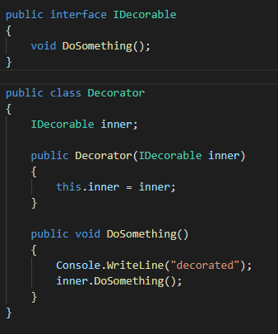
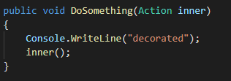
Move to functional
A lot of patterns…. Decorator using HOF

Slide 28
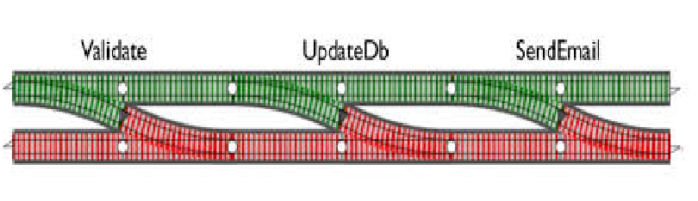
Move to functional
Railway pattern

Slide 29
Snippets
Functional programming

Slide 30

Move to functional
Snippets… language-ext
Don’t reinvent the wheel
Using the library language-ext https://github.com/louthy/language-ext

Slide 31
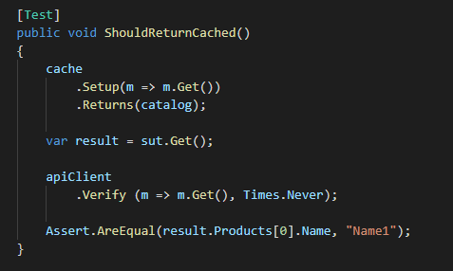
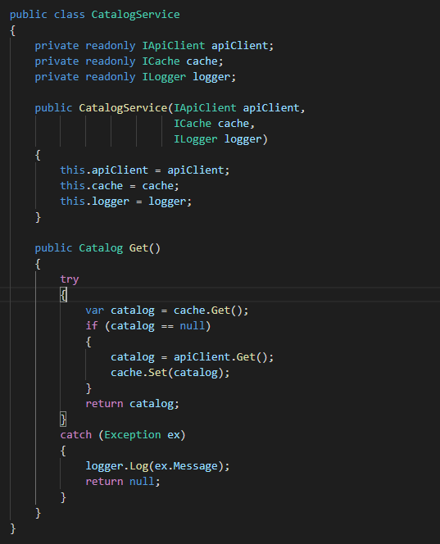
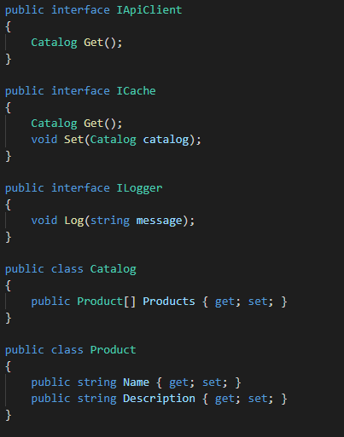
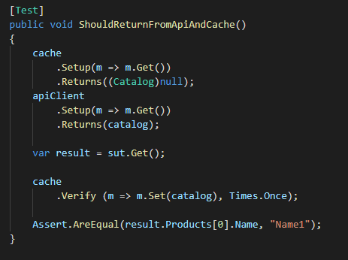
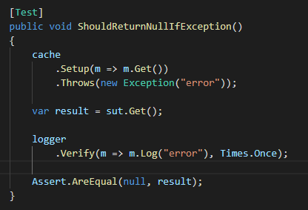
Move to functional
Get, Cache and Log

Slide 32


Move to functional
Get, Cache and Log

Slide 33
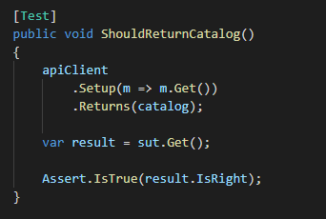
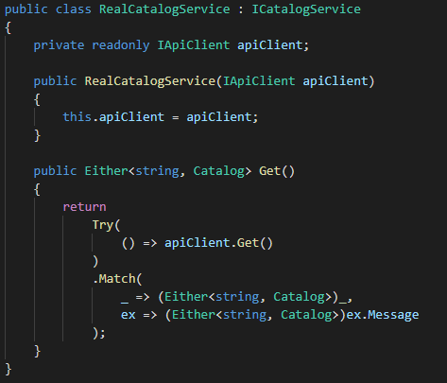
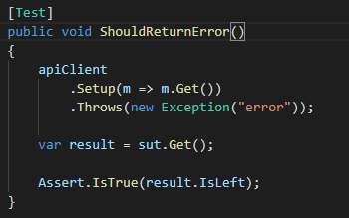
Move to functional
Get, Cache and Log…Decorating 1

Slide 34
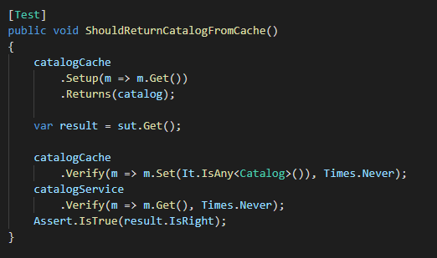
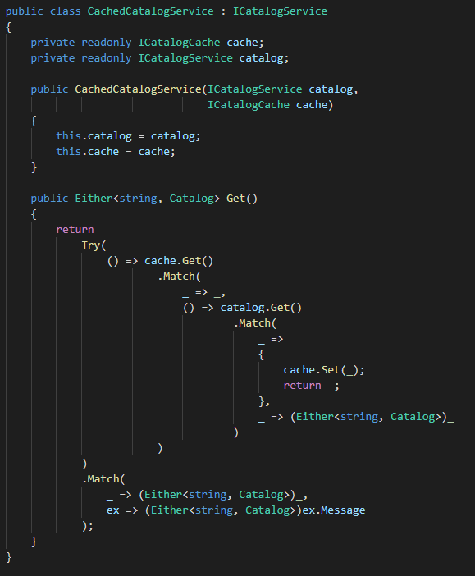
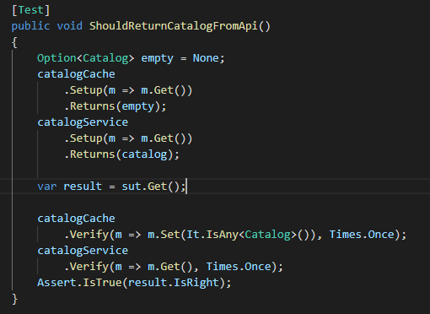
Move to functional
Get, Cache and Log…Decorating 2

Slide 35
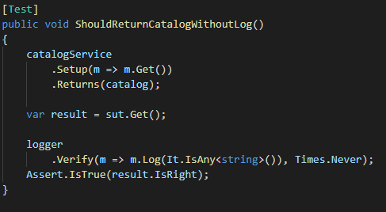
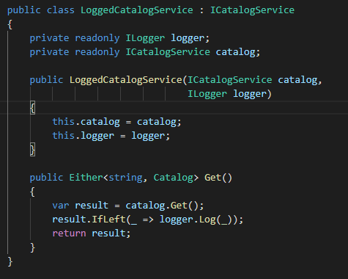
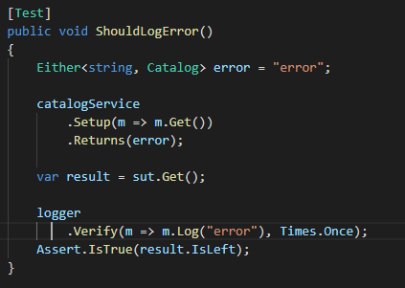
Move to functional
Get, Cache and Log…Decorating 3

Slide 36
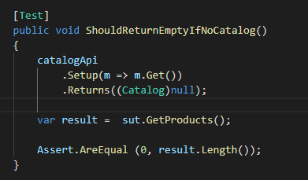
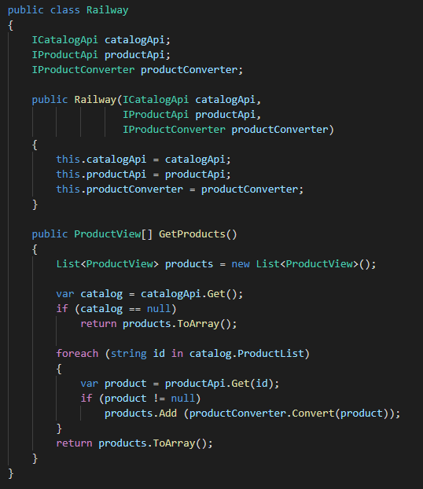
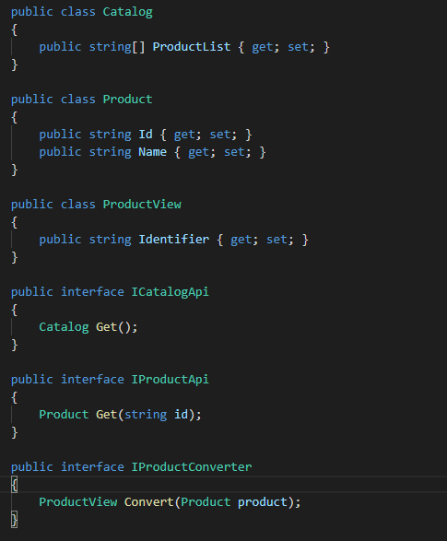
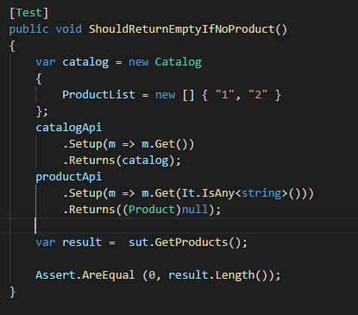
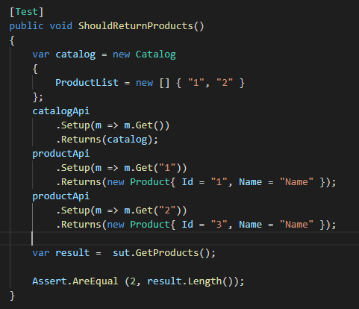
Move to functional
Get, Get, Convert and return (railway pattern)

Slide 37
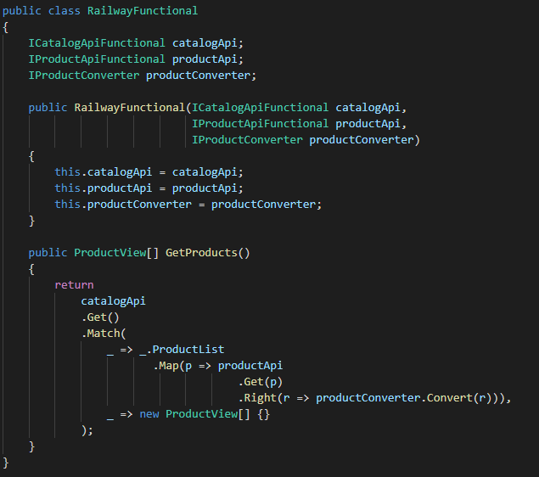
Move to functional
Get, Get, Convert and return (railway pattern)

Slide 38
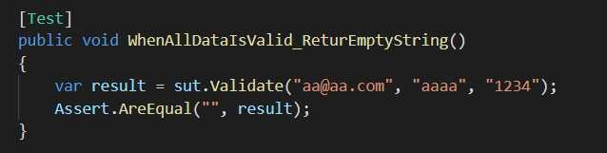
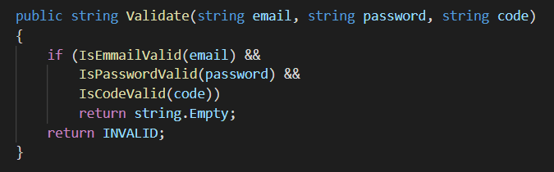
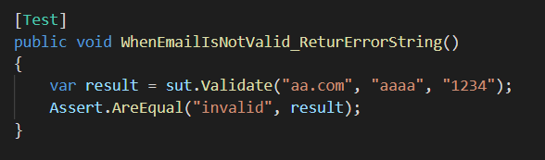
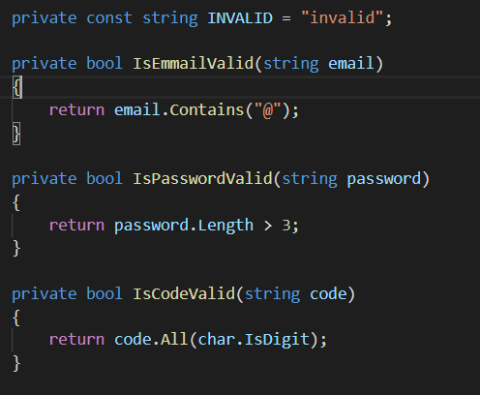
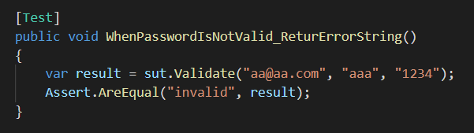
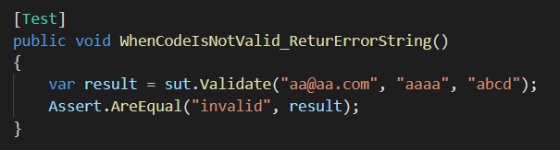
Move to functional
Validation … basic way

Slide 39
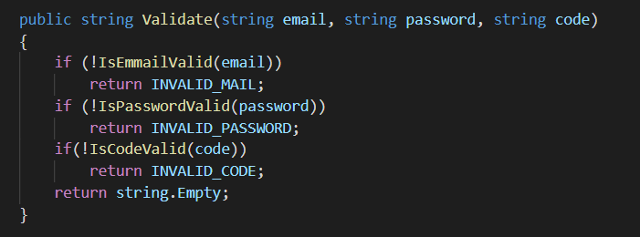
Move to functional
Validation … first improving

Slide 40
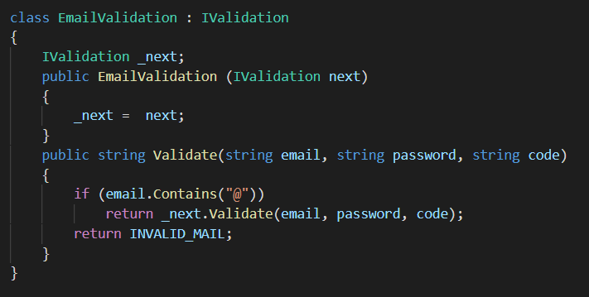
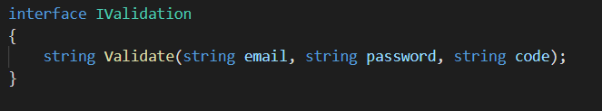
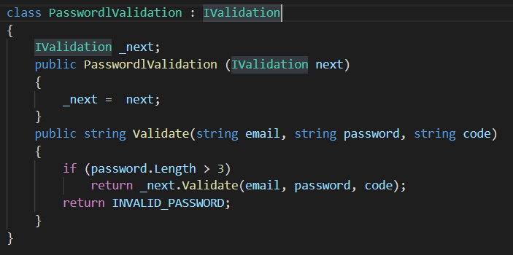
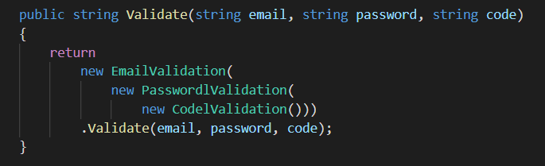
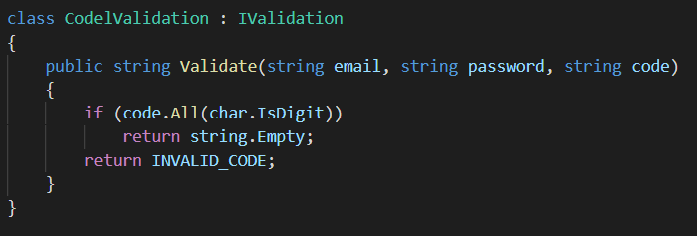
Move to functional
Validation … OOP Approach

Slide 41





Move to functional
Validation … Functional approach using Applicatives

Slide 42
Thank you!

